Slide 1

Two Decades Of Movies:
An analysis of movies available in Australia on Netflix, Stan and Amazon Prime Video.

Slide 2




Project Questions
Quality Which platform provides the best quality of film on average?
Genre Which genres have brought the most success over a 20 year period?
Diversity of Country Which platform’s films has the most diverse range of countries of origin?
Commercial Success Which platform hosts the most profitable films?
Notes:
Faded each one

Slide 3
Data Preparation
Collection, Cleaning

Slide 4


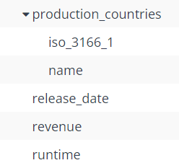


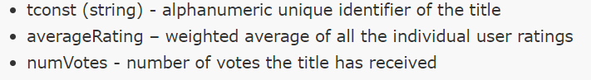
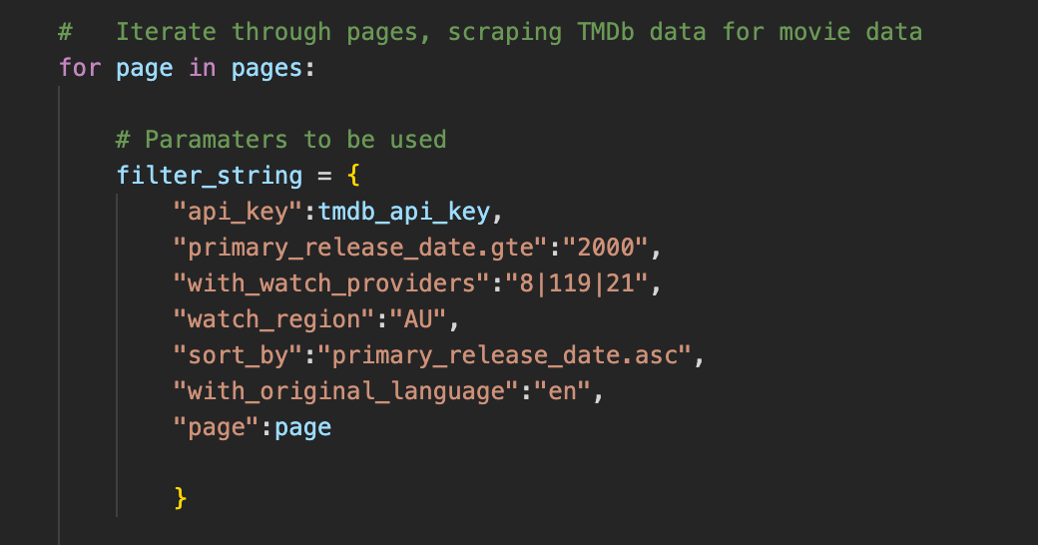
Data Collection
API Call - Discovery
API Call - General
IMDB CSV files
Allows use of params to filter movies
Acquired tmDB IDs for next API call
Requires tmDB movie ID
Acquired:
IMDB ids
Geographical information
Revenue information
Used to get supplementary information:
Genres of movies
IMDB ratings + vote count

Slide 5
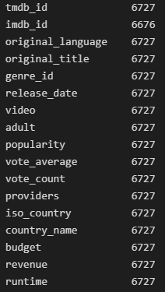
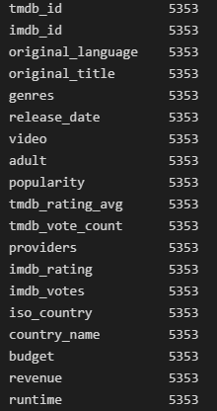
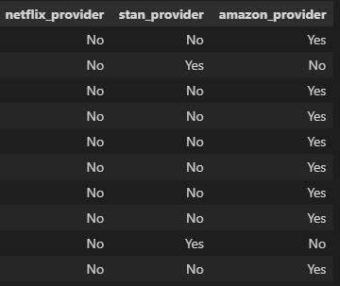
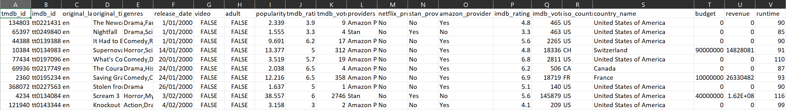
Data Cleaning
Initial dataset of 6676 movies (left merge imdb ids)
Removed all null values from dataset (majority came from revenue column)
Created separate Boolean columns for the providers

Slide 6
Quality
Which platform provides the best quality of movie on average?

Slide 7
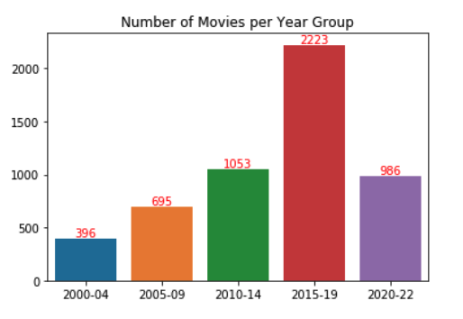
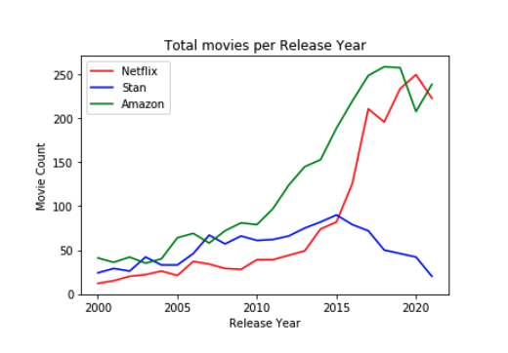
Volume
Which platform has the most films, and how old are they?
The majority of films on offer across all three providers were created in the past 10 years.
Netflix and Amazon have a higher number of films released on offer - with the majority of their offerings coming post 2015

Slide 8
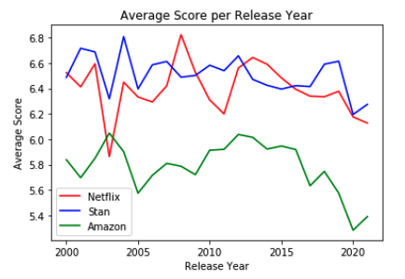
Ratings
Which platform provides the best quality of film on average?
On average, Stan has the highest quality rating (IMDb scores), despite having less of an overall range
Netflix comparatively has the best mix of quality and volume of films on offer.

Slide 9
Genre
Which genres have brought the most success over a 20 year period?

Slide 10
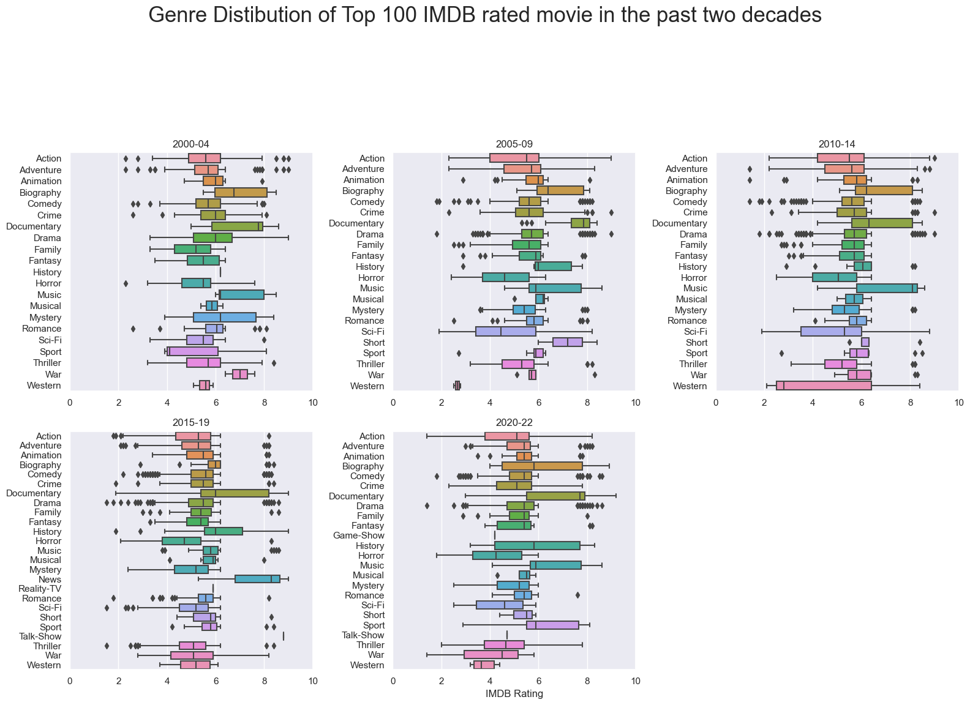

Genre
Which genres increased in popularity/rating over time?
Genre Distribution of Movies in the Past Two Decades
In grouped year 2015-19, Drama and Comedy movies have the most outliers from both ends of IMDB ratings
The least dominant genres for the past two decades are: Talk/Reality/Game-Show, Western, and War

Slide 11
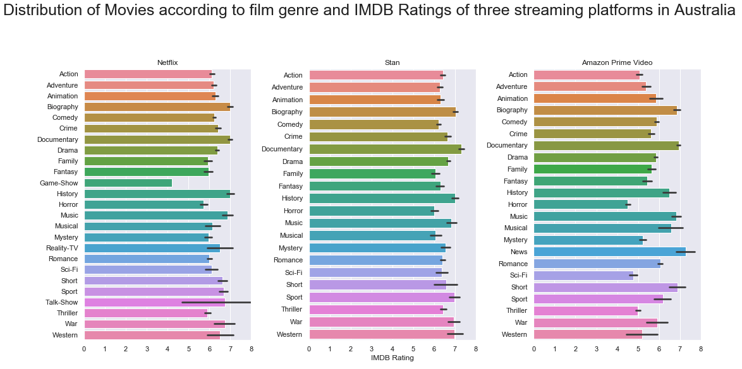
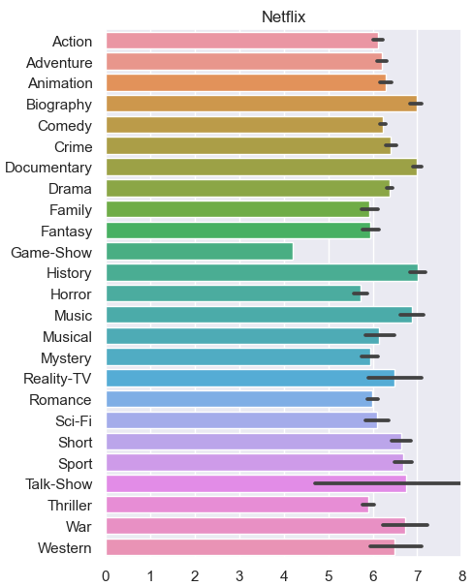
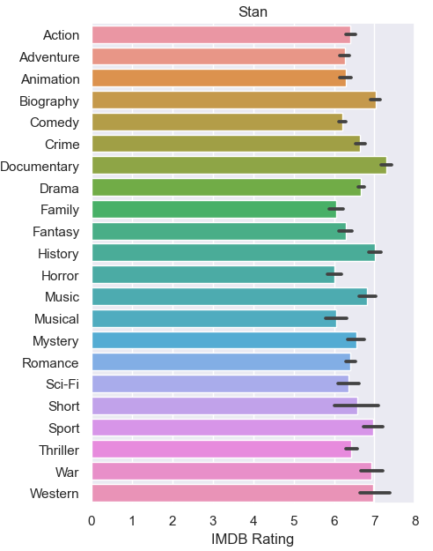
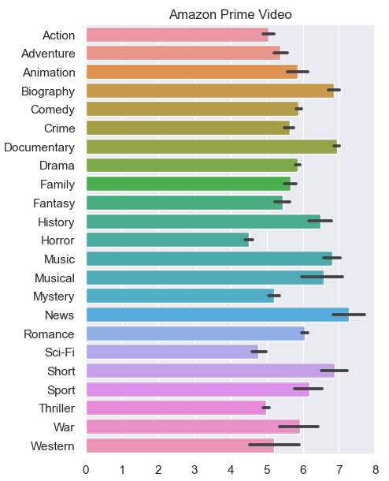
Genre
What are the genre distributions across the streaming platforms?
Netflix and Stan have a higher quality genre selection than Amazon.

Slide 12
Diversity of Country
Which platform’s films has the most diverse range of countries of origin?

Slide 13

Netflix
Large variety of locations across the world
Majority of films hosted on Netflix come from the US, UK, Canada and Australia.
UK and Australia are roughly the same in terms of number of films, and their quality scores.

Slide 14

Stan
Location of Origin not as widespread as Netflix or Amazon
Majority of films come from the US, UK and Australia.
Surprisingly, Stan has roughly the same amount of Australia films hosted as Netflix and Amazon despite being an Australian exclusive streaming provider.

Slide 15

Amazon
Largest variety of locations across the world
Dominated by US, UK and Canadian based content.
The overall of quality is lower on the scale in comparison to Netflix and Stan despite its wider range

Slide 16
Commercial Success
Which platform hosts the most profitable films?

Slide 17
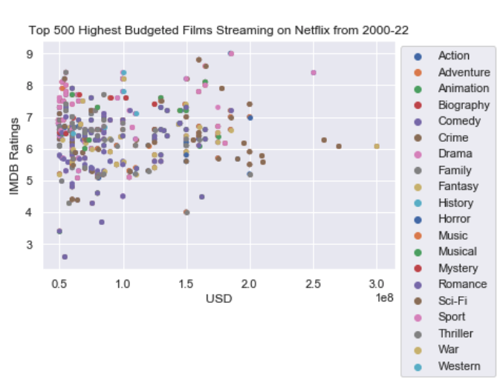
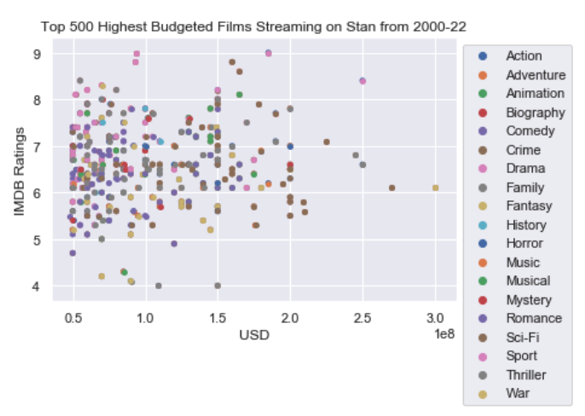
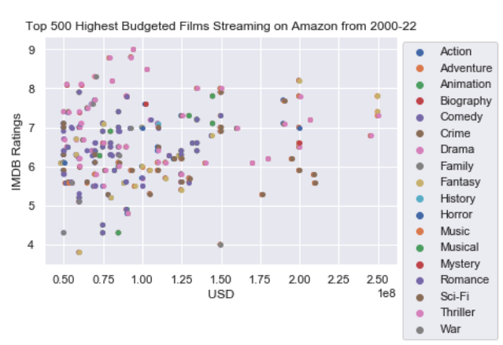
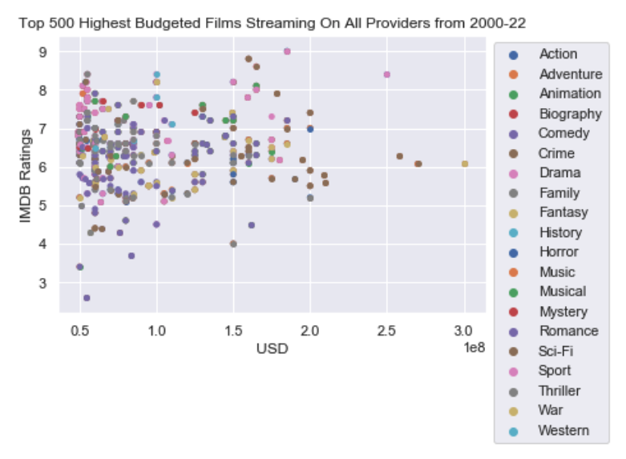
Budget
What correlation is there between budget size and average score?
Majority of genres have a budget less than 100 million in USD with rating score of 5 to 8
Netflix’s distribution shows most of the success rating doesn’t come down to larger budget productions
Amazon tend to house more movies with a larger budget
Notes:
Budget -Stacking

Slide 18
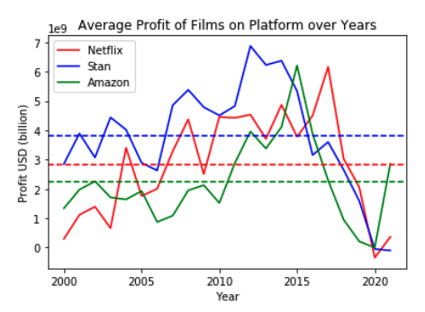
Profit
Which platform hosts the films that have made the most profit (deemed commercially successful)?
‘Profit’ = (Revenue - Budget)
The dotted average lines show the films Stan chose to host have made more profit than those on Netflix or Amazon.
Sharp decline in profitable films made 2015-2020 (original content?)

Slide 19
Limitations
The Movie Database (TMDB) has incomplete information on some movies: budget, revenue, ratings, etc.
Notably, revenue numbers for 2022 movies were missing
Only movies that were in English were included.
IMDB scores are the only source for gauging the film quality

Slide 20
Conclusion
It’s fair to say based on this analysis, that there’s a case to be made for each of the streaming providers.
Netflix is the most ‘well-rounded’ provider on the market currently.
Stan has the highest quality of film and even spread of quality across genre, but lacks in number of films to watch and diversity of country.
Amazon Prime boasts the largest range of films from the largest selection of countries, but on average the quality is much lower than what the other providers offers.
Not only does Netflix have a large number of films from a diverse selection of countries, but the quality of the films it hosts is only marginally worse than Stan - even offering a ‘Game-Show’ genre the other two providers don’t.

